Slide 1
Alternating-laser Excitation (ALEX) Implemented In Single-molecule Studies
Corey Short
Monterey Peninsula College
ACCESS Summer Research Institute 2012
Professor Michael Stone
University of California Santa Cruz
Department of Chemistry & Biochemistry
Notes:
Intro –however, set expectations to audience. New experience. Not my area of expertise, all new to me. My emphasis is Comp Sci.

Slide 2
Why Use Single-molecule Techniques?
Ensemble (bulk) technique.
Single-molecule studies (SMS).
Elasticity and force.
Mechanically induce structural changes.
Notes:
Single-molecule studies has emerged as a technique to study the mechanisms of complex biological macromolecules, such as protein or RNA folding.
The chief reason SMS is advantageous is because it allows us to investigate the properties of individual molecules.
This may be contrasted with measurements on an ensemble collection of molecules where individual behavior of molecules cannot be distinguished – only the average behaviors can be measured.
Measuring elasticity, force, and mechanically induced structural changes are examples of micromanipulation techniques used in single-molecule spectroscopy.

Slide 3
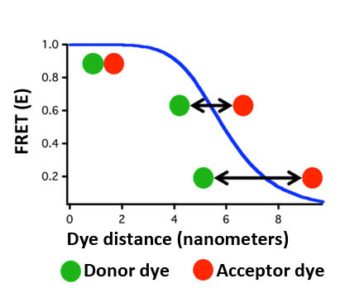
Single-molecule Förster Resonance Energy Transfer (smFRET)
I_{A}
(I_{A} + I_{D})
FRET =
Photophysical effects:
Photobleaching
Blinking
http://www.dkfz.de/Macromol/research/smfret.html
http://www.molecular-beacons.com/toto/images/FRET.jpg
Notes:
Donor excited and light is emitted, this is how fluorescence works. In FRET acceptor dye is added and depending on distance there is emission and energy transfer..
smFRET is a powerful method for monitoring nanometer scale motions within biological macromolecules, measured as the efficiency of energy transfer between donor and acceptor dyes. FRET is basically a spectroscopic ruler. Graph of High fret and low fret. FRET efficiency is 50% around the middle.
Add circles. Greater than 8nm. Add light from donor and FRET ratio. Next slide spectroscopic ruler and hairpin DNA. Define challenge, add photobleaching problem. Irreversible damage to dye, causes it to go dark. Photobleaching bullet. Maybe blinking? Animate FRET diagram. Basically, if you have a FRET of 1 then all of your intensity is coming from the Acceptor dye.
Blinking- dye goes into state where its temporarily unavailable for energy transfer. Transition into using FRET and MT on hairpin DNA

Slide 4
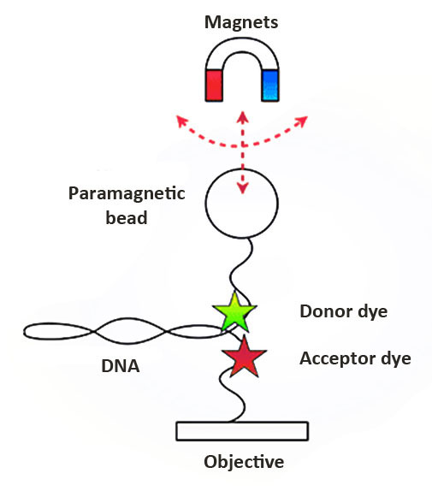
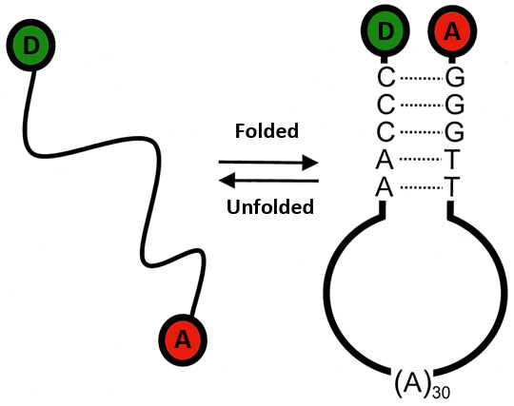
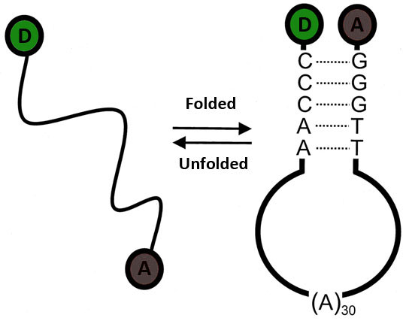
smFRET Integrated with Magnetic Tweezers (MT-FRET)
Hairpin DNA
http://www.pnas.org/content/98/10/5584/F1.large.jpg
http://www.michaelschlierf.com/images/research_ma.png
Notes:
Recently, the integration of FRET and MT (MT-FRET) has become possible. This is novel because it permits researchers to mechanically manipulate molecules with MT while simultaneously measuring dynamic structural properties by smFRET. In our hairpin DNA experiment, the folded and unfolded state of the DNA is manipulated with the force the magnets. MT is a second single-molecule technique that permits the application of tension and torques to individual DNA molecules. One side of the DNA is anchored to the objective and the other to a paramagnetic bead. Magnets are used to apply torque and torsion force to measure the elasticity and mechanical structural properties of biological macromolecules. Hairpin DNA fold and unfolds depending on FRET and MT.
Show hairpin and folding transitions. Introduce model system. Add high/low fret to hairpin. Introduce hybrid system.
Frame problem in hairpin model. add third picture hairpin no color photobleaching with no or low fret.
Talk about pulling hairpin and applying force. Animate photobleached hairpin in. how to distinguish between zero fret state and photobleaching?

Slide 5
How can we differentiate between low FRET and a photophysical effect?
Notes:
Restate challenge. Transition into introducing another technique to solve this problem.

Slide 6
Hypothesis
The implementation of ALEX should give us the ability to differentiate between the actual physical state of the DNA, folded versus unfolded, or if low FRET is due to a photophysical effect.
Notes:
Directly exciting acceptor during FRET can differentiate between low fret and blinking/photobleaching.

Slide 7
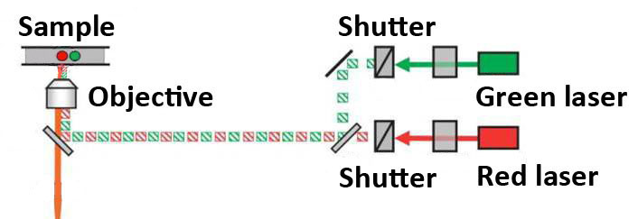
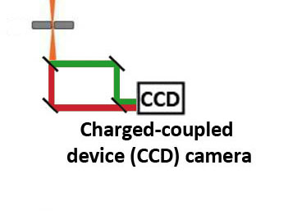
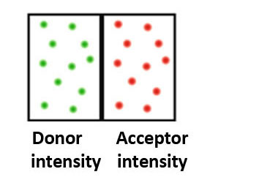
Alternating-laser Excitation (ALEX)
http://ars.els-cdn.com/content/image/1-s2.0-S0006349505733464-gr1.jpg
Notes:
A green and red laser, donor and acceptor lights respectively, are emitted through shutters. The shutters alternate the light, and the resulting alternating light spectrum enters the objective. The light spectrum enters a slit and is emitted through dichroic mirrors that split the red and green spectrum of light into the CCD camera. An image of the bead intensity is displayed on the computer screen. By this technique, the two dyes in the sample are excited directly and we are able to determine the physical state of the hairpin DNA by analyzing the image on the computer.

Slide 8
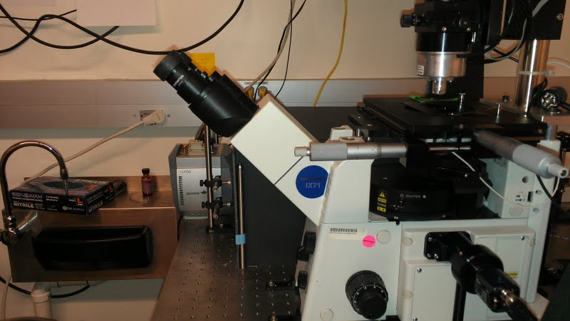
MT-FRET Instrument
Apply force
Magnets
Objective
CCD Camera

Slide 9
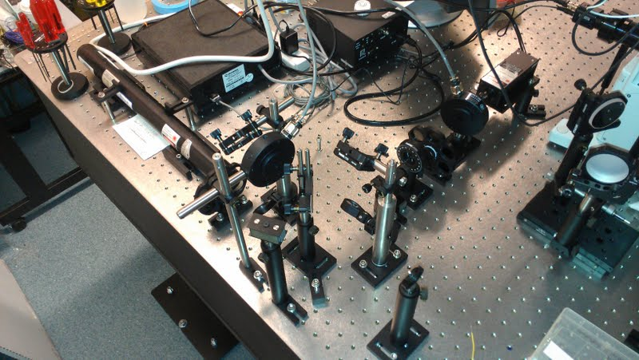
MT-FRET Instrument
Green laser
Red laser
Shutters
Shutters

Slide 10




Shutter Control Diagram
Frame transfer
Line to red shutter
Line to green
shutter
Notes:
The CCD camera captures a signal and outputs the data to the digital I/O of the DAQ control board. The DAQ is wired to the shutters and it outputs a signal to open/close the shutters as shown. The program to sequence the shutter control is written in National Instruments LabVIEW 8.6. Transition into block diagram code.

Slide 11
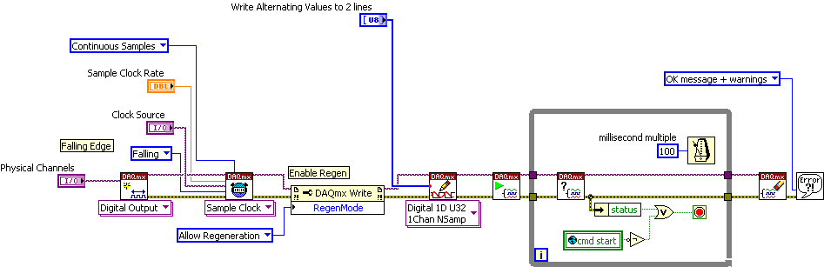
ALEX Block Diagram
Notes:
Now lets look at the code. Just kidding. Talk about not being trivial as Shutter diagram. We won’t go into that sort of depth here. Just know it works. Shutters video transition.

Slide 12
Alternating Shutters Video
Missing video of shutters working.

Slide 13
Hairpin DNA Data
Notes:
Introduce graph and axis. Increase font on Time. In seconds. Every peak in FRET is because the donor has succusfully transferred energy to the acceptor. Add photobleach.

Slide 14
Results
Alternating-laser excitation is a tool to differentiate if a dye has blinked or been photobleached during low and zero FRET states.
Future Direction
A wide range of experiments in Stone Lab will take advantage of this application.
Notes:
It works!

Slide 15
Acknowledgements
Professor Michael Stone
Joe Parks
Salina Long
ACCESS Program
Professor Phil Crews
Pam D’Arcey
Dr. Sarah Gerhardt
Justin Daily – National Instruments
National Institute of Health

